Slide 1
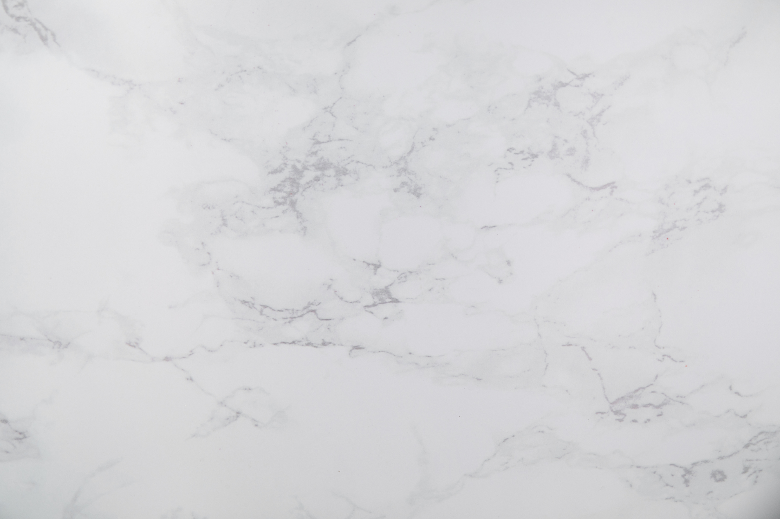

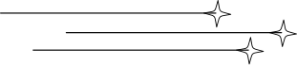
Ji’ROOF
PRODUCT

Slide 2

About Us
Based in Madagascar, our activities has been dedicated to the production of clove essential oil and the collection of vanilla and clove since XXXX. For decades, we have supplied trusted exporters with high-quality raw and processed spices. Today, we are proud to take the next step – exporting and selling our own products directly to local and international markets, with a special focus on client in the gourmet food service industry.
By working hand by hand with local artisans and cooperatives, we ensure each product reflects our values : authenticity, ethical sourcing, and deep respect for the land and people behind every harvest. Our mission is to share the best of Madagascar with the word – responsibility, transparency and sustainability.

Slide 3
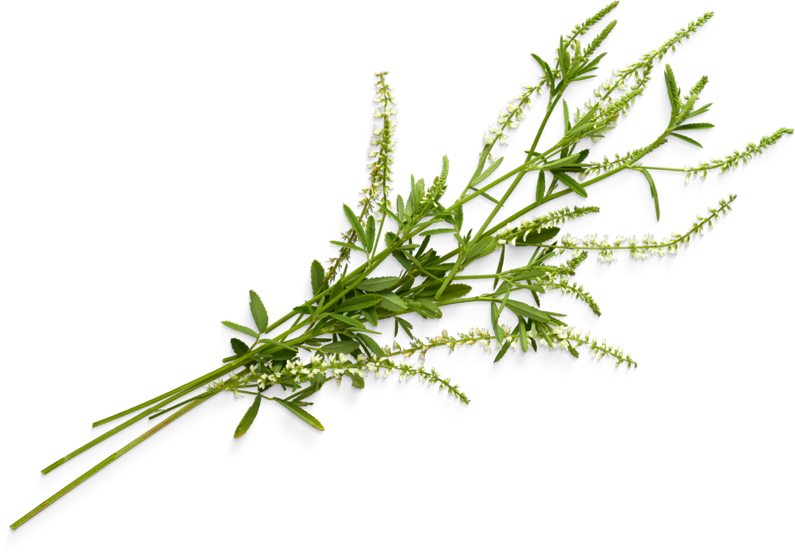
About Our Product
Origin :
Analanjirofo, MADASACAR – The Hearth of spices
Analanjirofo is like an elder, wise and deeply rooted in tradition. Situated on Madagascar’s lush northeast coast, she thrives in the tropical rains and fertile soil, nurturing some of the word’s finest spices.
Values :
More than a premium quality – we carry the soul of a land and the hands of its people
Aromatic treasures – known for their deep, complex aromas and unmatched authenticity
From field to export – to deliver product that’s both artisanal and reliable
Standing for ethical trade – ensuring fair income and sustainable impact

Slide 4
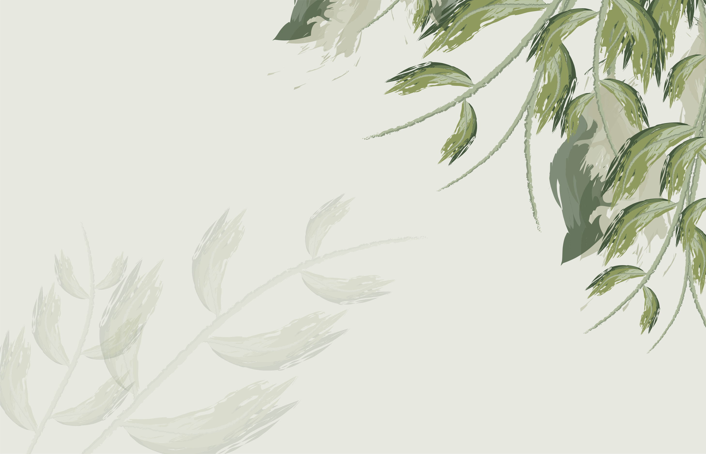
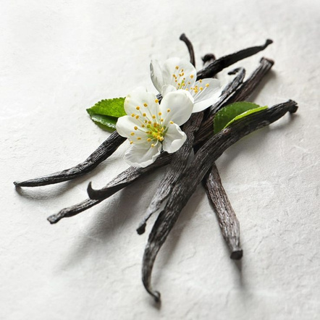
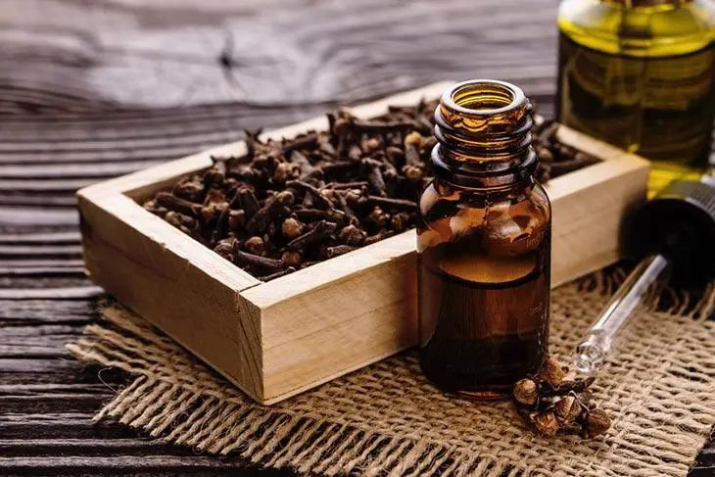
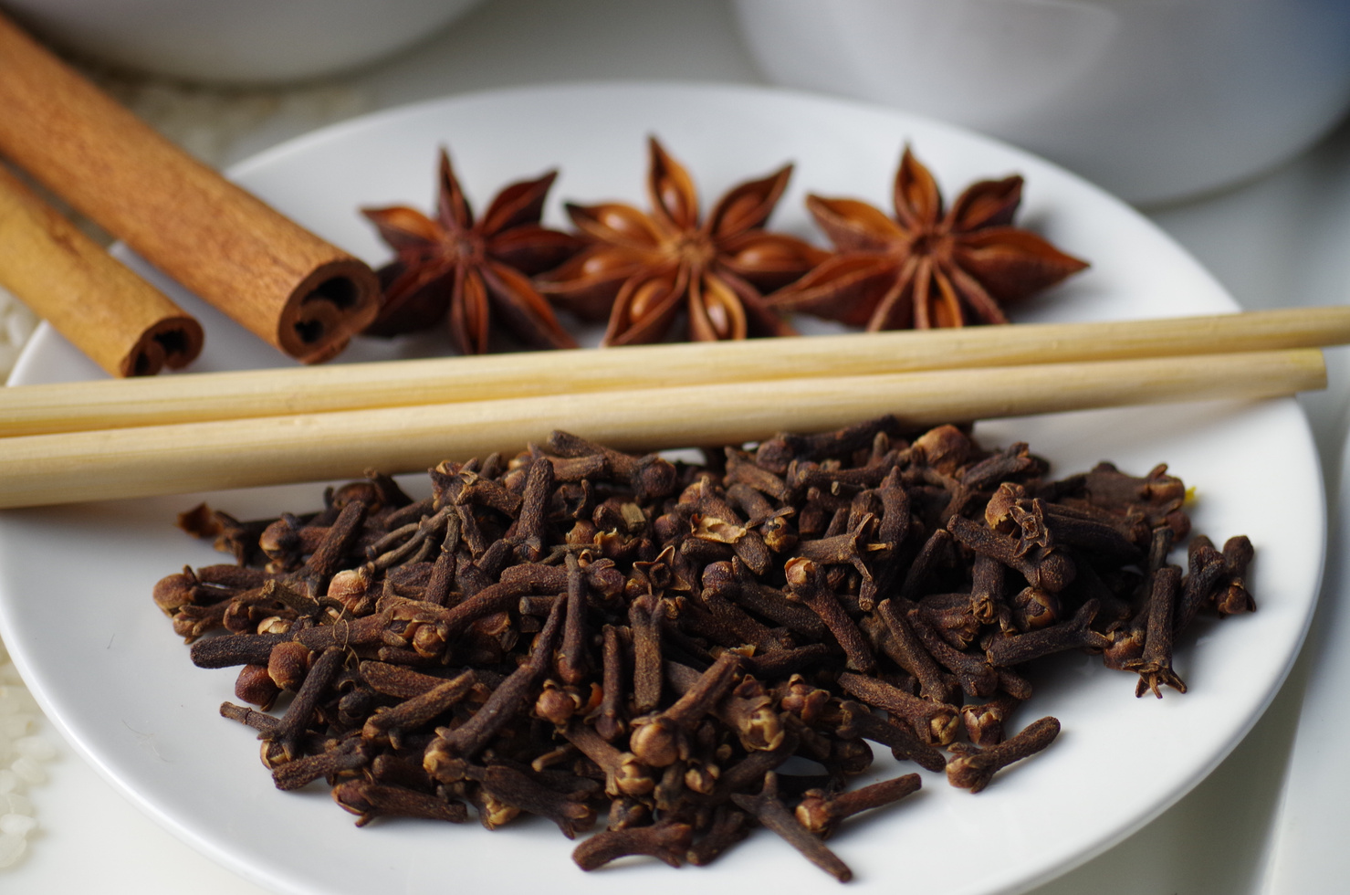
Product List
VANILLA
CLOVE ESSENTIAL OIL
CLOVE

Slide 5
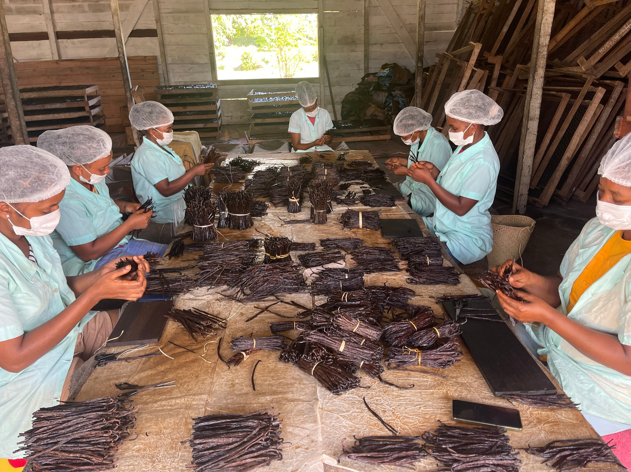
# 1 VANILLA
Les Noirs
Noir 1
Noir 2
Noir 3
Les Rouges
Rouge 1
Rouge 2
Rouge 3
La Verte

Slide 6
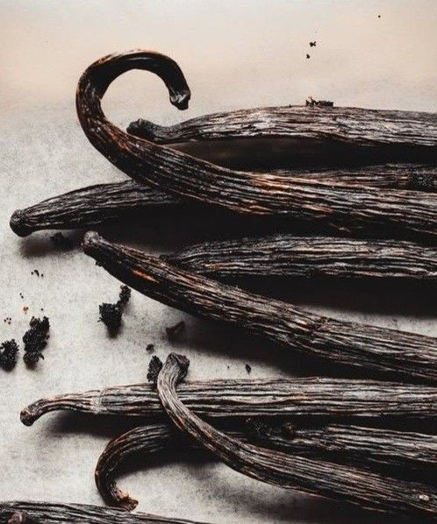
La Vanille Noir
Premium black vanilla
With soft pods, shiny, and full of natural vanillin, this vanilla is carefully prepared in Madagascar using traditional methods.
Ready to use and brings a rich, refined, flavor to high-end products.
Examples of use : Fine pastries and gourmet desserts, flavored rum and spirits, natural cosmetics and perfumes, ...
Prices :
NOIR 1 : 175 000 MGA / kg
NOIR 2 (TK) : 164 000 MGA / kg

Slide 7
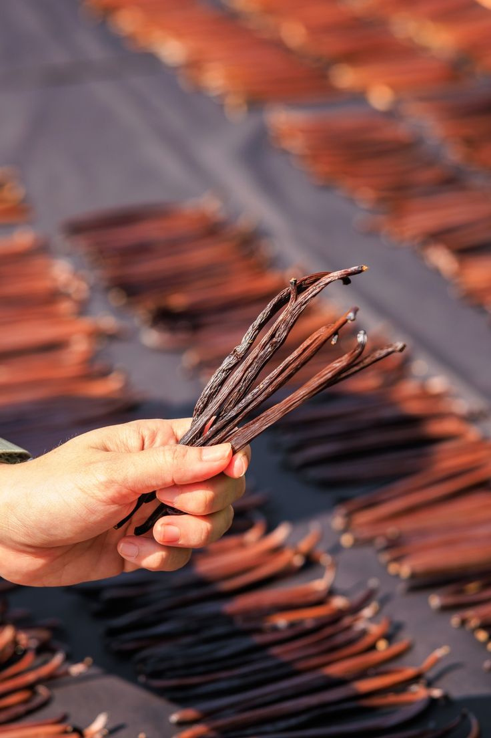
La Vanille Rouge
Red vanilla
This vanilla is slightly dried and perfect for professionals who work with large volumes. Has good flavor yield and good choice for making natural vanilla products.
Examples of use : Vanilla extract production, chocolate and candy making, dairy products like yogurt and desserts, flavored beers and drinks, …
Prices :
ROUGE 1 : 140 000 MGA / kg
ROUGE 2 : 125 000 MGA / kg
ROUGE 3 : 100 000 MGA / kg

Slide 8
#2 CLOVE ESSENTIAL OIL
General Description:
Clove essential oil is obtained through steam distillation of the dried flower buds of the clove tree. Renowned for its powerful aromatic and therapeutic properties, it is distinguished by its warm, spicy, and slightly woody fragrance.
Key Characteristics:
Appearance: Clear to pale yellow or golden brown liquid.
Aroma: Strong, warm, spicy scent with subtle fruity notes.
Botanical Source: Syzygium aromaticum (family Myrtaceae).
Extraction Method: Steam distillation.
Plant Part Used: Dried flower buds (cloves).
Price :
55 000MGA /L
Bientôt certifié BIO !!!

Slide 9
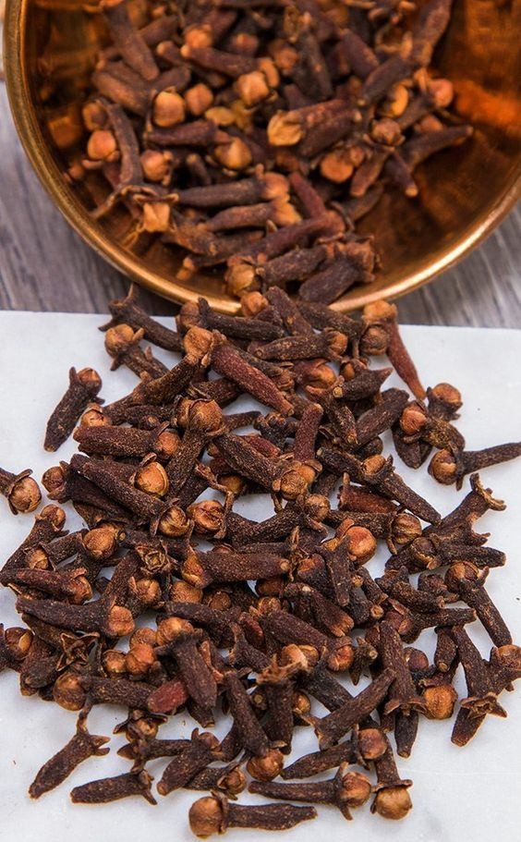
#3 PREMIUM WHOLE CLOVES
The Authentic Taste of the Indian Ocean
Product Highlights:
100% Natural & Handpicked: Carefully harvested before blooming and sun-dried to lock in maximum flavor and aroma.
Rich Aroma & Bold Flavor: Warm, spicy, and slightly sweet scent with a distinctive, pungent taste
Superior Quality: Uniform dark brown color, firm texture
Sustainable Origin: Responsibly sourced from the fertile lands of Madagascar
Flexible Packaging Options: Available in burlap sacks, food-grade cartons, or airtight pouches — tailored to your needs.
Ideal For:
Perfect for culinary, cosmetic, and wellness applications.
(Gourmet food industries, tea and beverage companies, spice wholesalers, natural cosmetic brands, and aromatherapy specialists).
Price :
50 000 MGA / kg

Slide 10
WHY CHOOSE OUR PRODUCT ?
A product line tailored for our client : personalized and reliable service
100% Artisanal Quality : Grown and hand – processed in Madagascar for bold, natural flavors
Ethical sourcing : Fair trade practices that support local farmers and communities
Full transparency : Clear origin and quality you can trust from farm to shipment
Authentic Alternative : A human story behind every product – honest and unique

Slide 11




Contact Us
+ 261 32 98 064 36
jiroof.cny@gmail.com
@jiroof_cny
101 Antananarivo, MADAGASCAR

Slide 12
Thank You
To Generation of skilled farmers who rise with the sun and care for each cloves and vanilla pod by hand
To The local cooperatives and collectors who ensure fairness, traceability, and consistency quality,
To The distillers and curers who reveal the soul of each spice
To The silent hand that pack, label and inspect each shipment with care
To our future Canadian partners and early clients who believed in Madagascar’s richness, your trust fuels our mission

